Slide 1
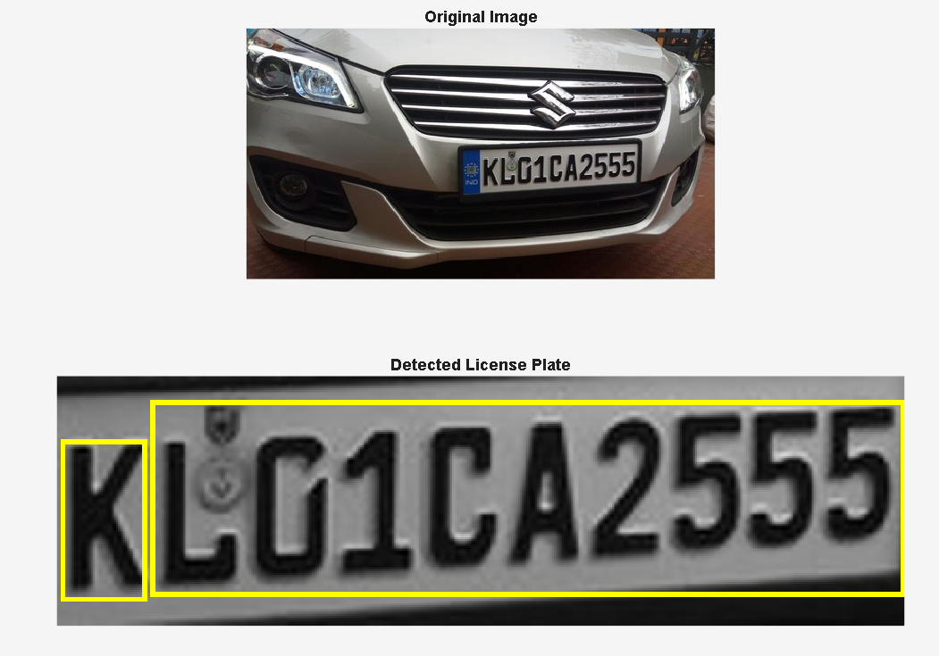
Project: License Plate Detection
Prepared by: Ahmad Chamiye and Karim Sakr
ELE552: Digital Image and Video Processing and Compression
Instructor: Dr. Claudia Mattar

Slide 2
Phase 1: Plate (Rectangle) Detection.
Goal: Detect the rectangular shape of the car plate.
No focus on the plate as it is, more focus on areas, ratios and regions.

Slide 3
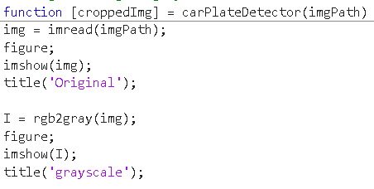
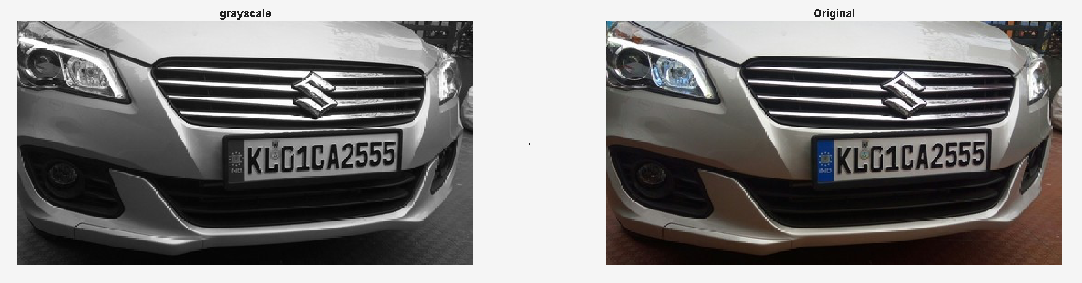
Original Image and Grayscale

Slide 4
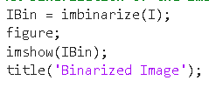
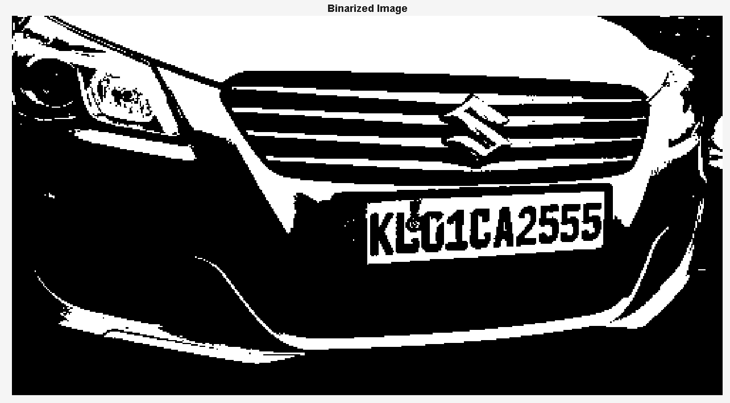
Binarization of Image
Essential to obtain clearer features.
Transforms image into 1s and 0s. (pixels are either white or black)

Slide 5
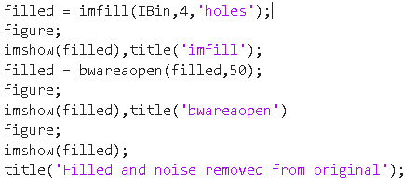
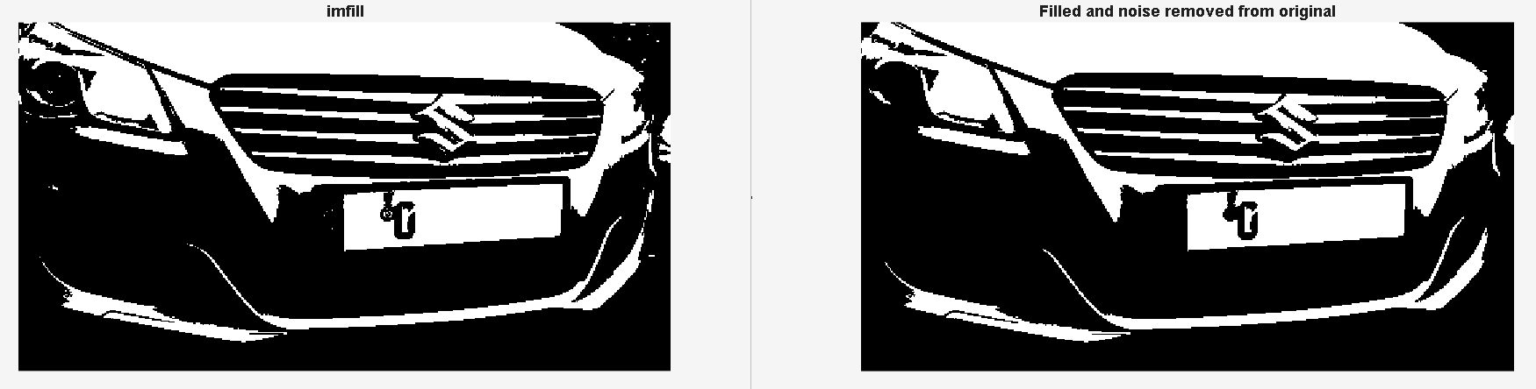
Filling Holes
Filling holes → imfill: fills in small black gaps inside white objects.
Noise removal → bwareaopen: removes small white speckles (noise) that are too tiny to be a license plate.

Slide 6
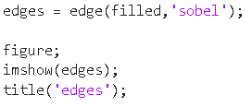
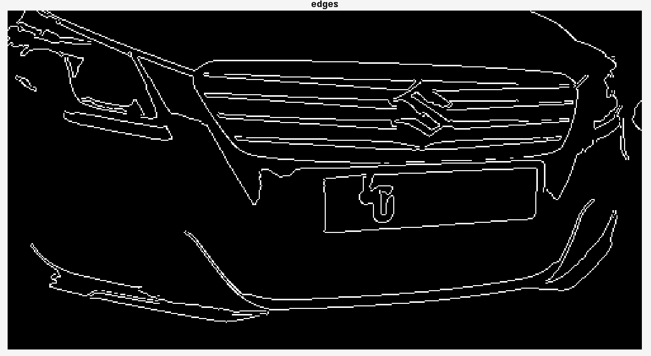
Detect Edges
Edge detection using the edge function:
We use the Sobel filter that identifies areas of high contrast.
White areas are delimited and edges are detected.

Slide 7
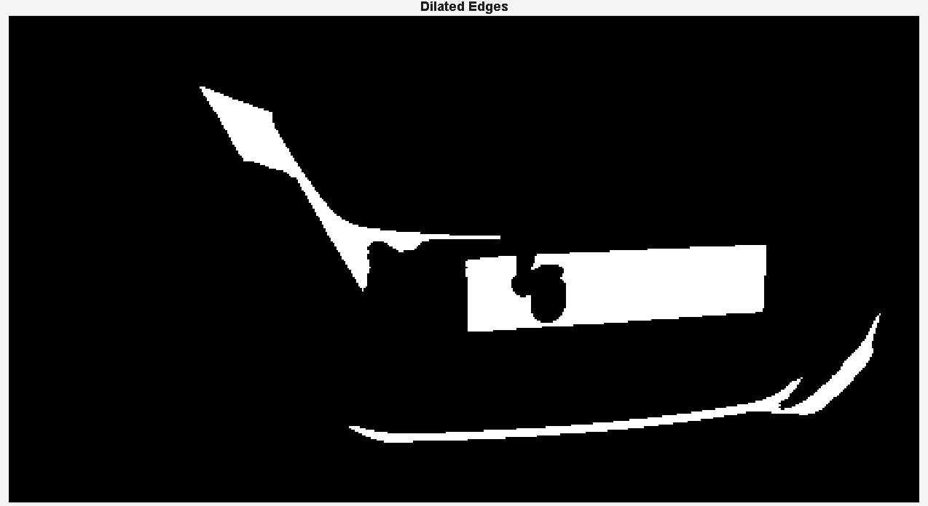
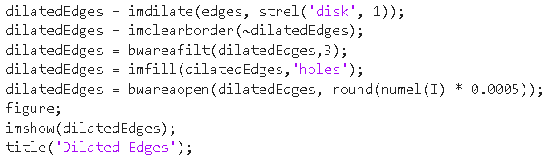
Perform Morphological Dilation to Enhance Edges
Dilation:
imdilate thickens the edges → helps connect disconnected lines
Filtering:
imclearborder removes any object touching the edge of the photo.
bwareafilt keeps only the top 3 largest objects.
Bwareaopen: removes small objects (noise) but based on size.

Slide 8
Rectangular Region Detection
Get properties of top candidates.
Check minimum area based on threshold.
Check for Square or Rectangular shape.
Compare with real car plate ratio.

Slide 9
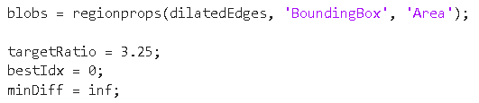
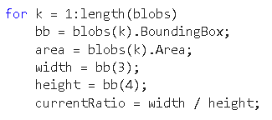
Properties, Threshold and Ratio Definition
We got 3 different regions → get their properties (‘BoundingBox’ and ‘Area’)
Area: total number of pixels in a region
BoundingBox: smallest rectangle that can completely contain a region (Even if the region is not a rectangle).
Getting the current area and ratio of each region.

Slide 10
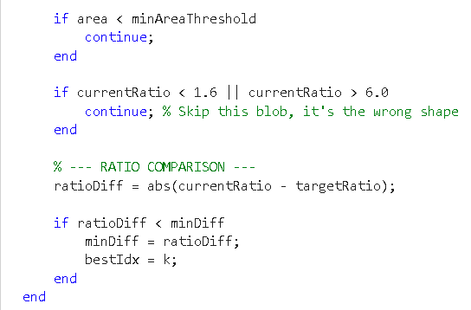
Conditions Check
Check for Area to be above required minimum threshold
Check for ratio to be similar to rectangle rather than a square
Check for the ratio difference for similarity with generic ratio of license plates.

Slide 11
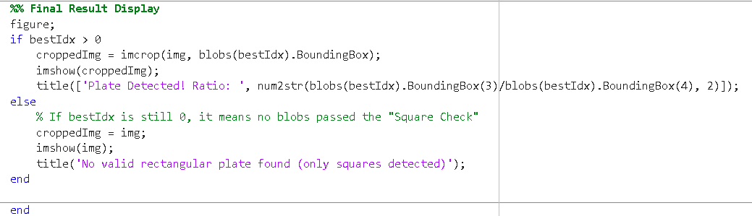
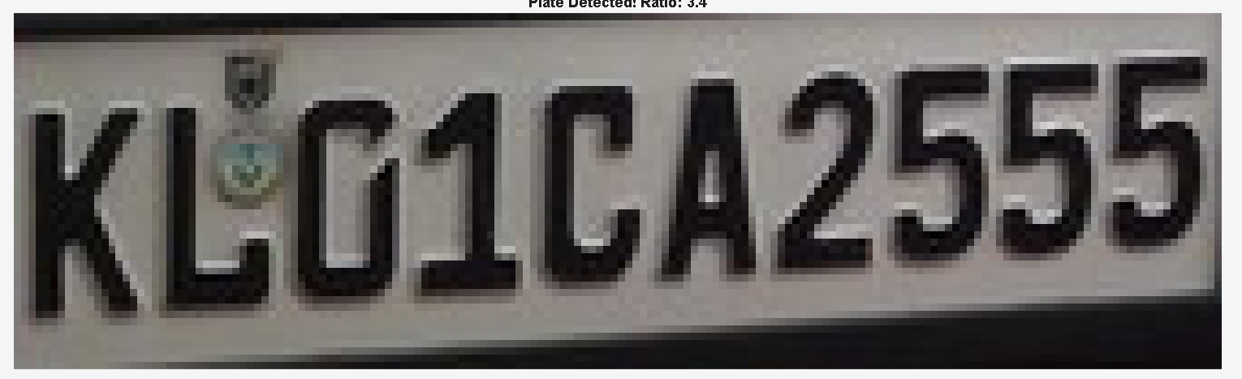
Plate Detected!

Slide 12
Phase 2: Character Detection

Slide 13
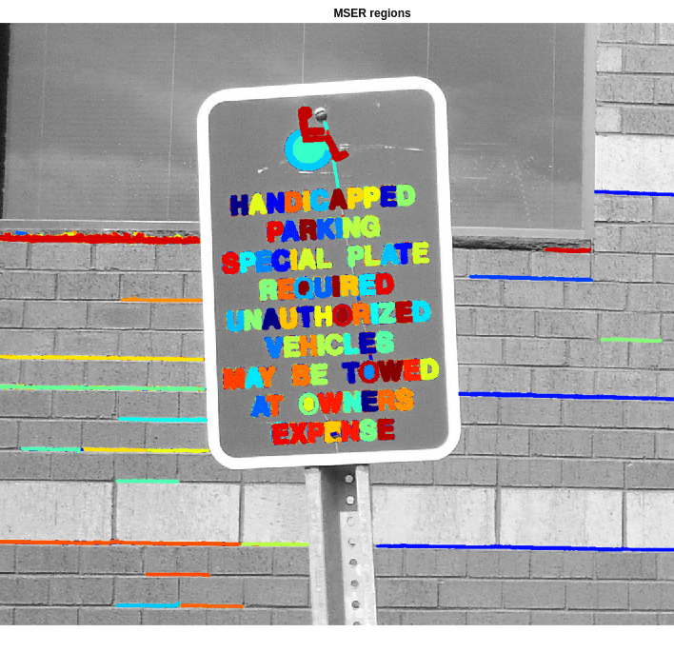
Plate number and region reading from plate using OCR and MSER
It is a two-step procedure: segmentation and reading text from the image
MSER is first applied then after segmenting the text regions, OCR is applied to the regions that contain text to determine the character strings present in the segmented region.

Slide 14
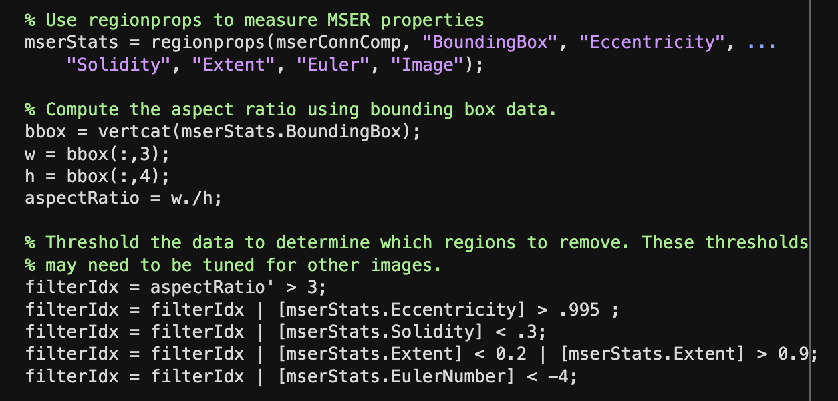
Removing Non-Text Regions
Geometric properties of text can be used to filter out non-text regions using simple thresholds. Alternatively, you can use a machine learning approach to train a text vs. non-text classifier.
Some of these geometric properties are:
Solidity
Aspect ratio
Eccentricity
Euler number
Extent

Slide 15

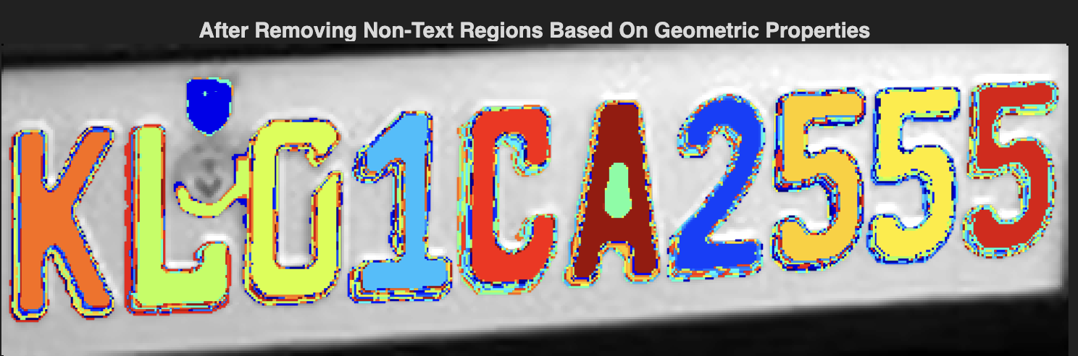
Comparison of before and after removal of non-text elements

Slide 16

Alternative removal method (Stroke Width)
Another common metric used to discriminate between text and non-text is stroke width. Stroke width is a measure of the width of the curves and lines that make up a character. Text regions tend to have little stroke width variation, whereas non-text regions tend to have larger variations.
To help understand how the stroke width can be used to remove non-text regions, estimate the stroke width of one of the detected MSER regions. You can do this by using a distance transform and binary thinning operation

Slide 17
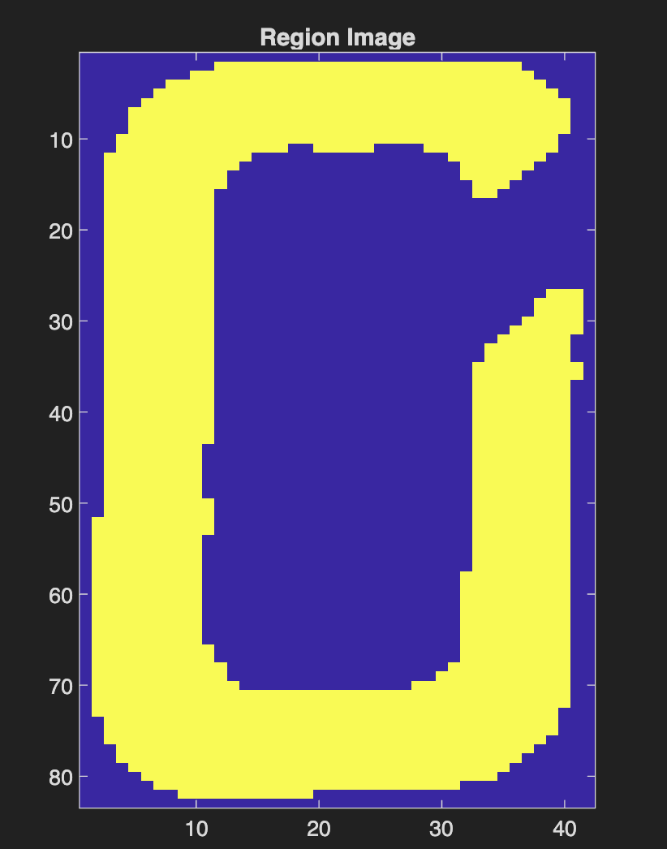
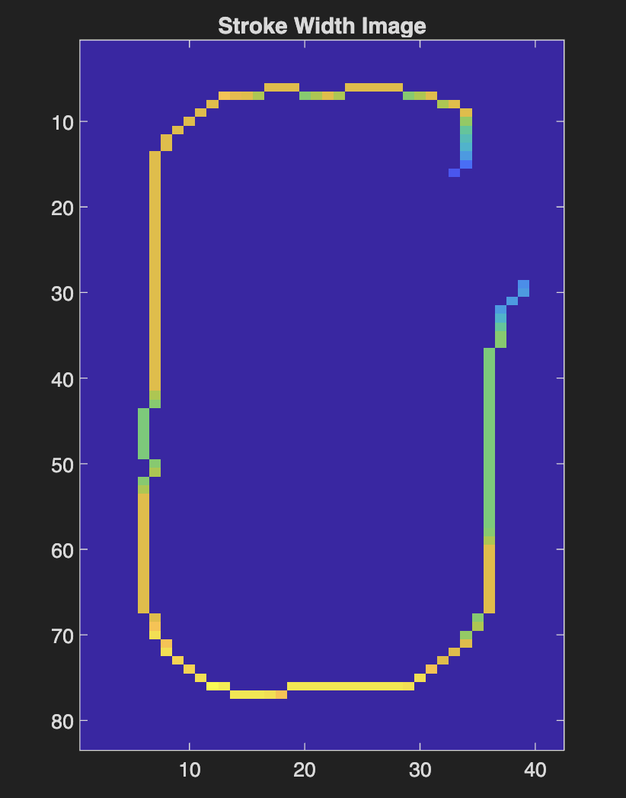
Comparison of regions before and after stroke width

Slide 18
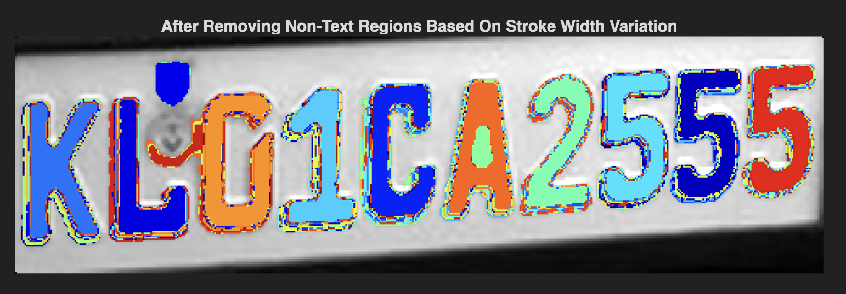
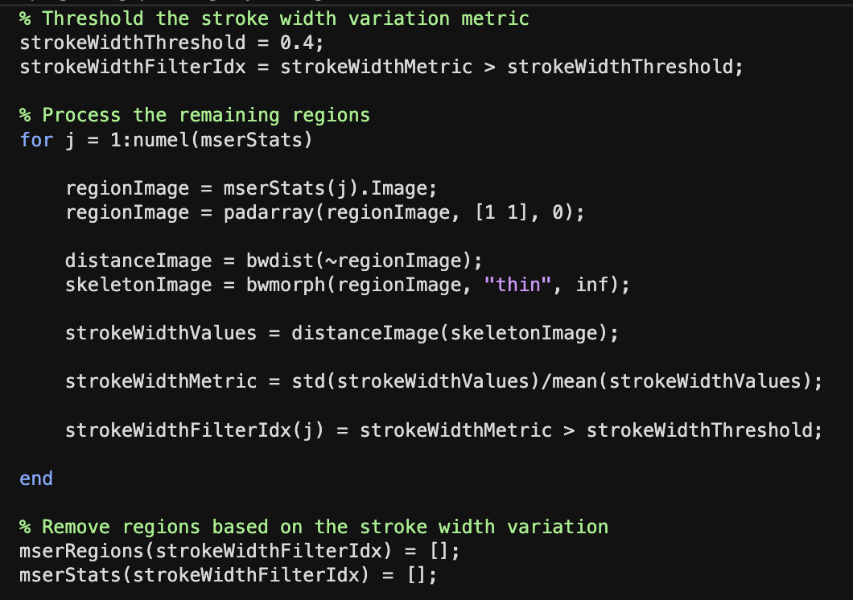
Code Sample and image using stroke width

Slide 19
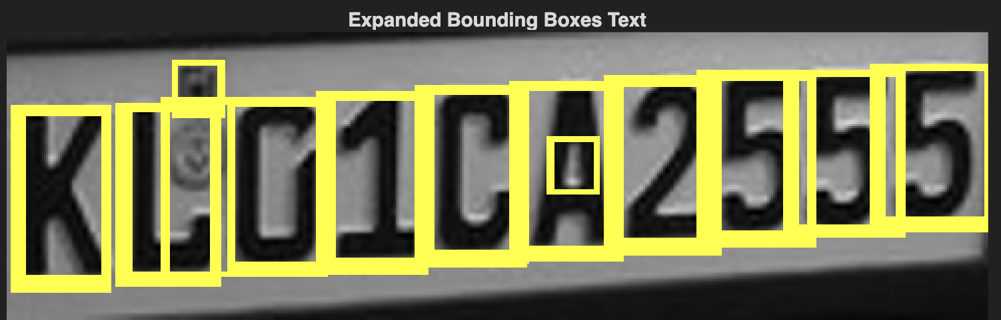
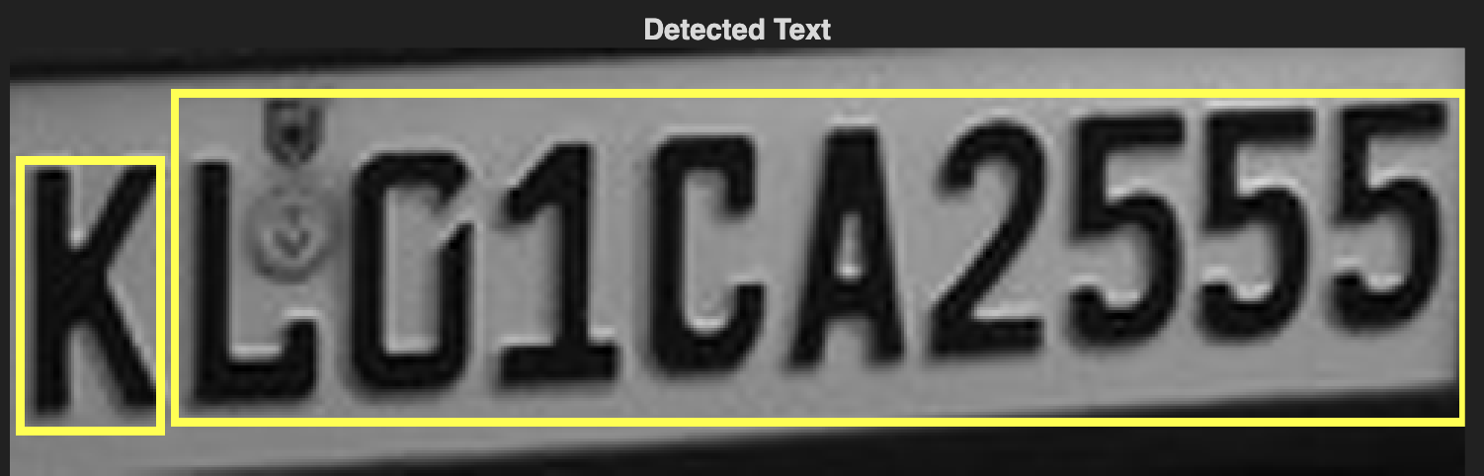
Merging text regions for final detection
Detection outputs start as separate characters, but for tasks like OCR they need to be grouped into words or lines. This merging preserves order and meaning, allowing recognition of actual text (e.g., “EXIT” instead of an unordered set of letters).
To merge detected characters into words or lines, expand their bounding boxes so nearby characters overlap. These overlaps link neighboring regions into chains, allowing them to be grouped into a single word or text line.

Slide 20
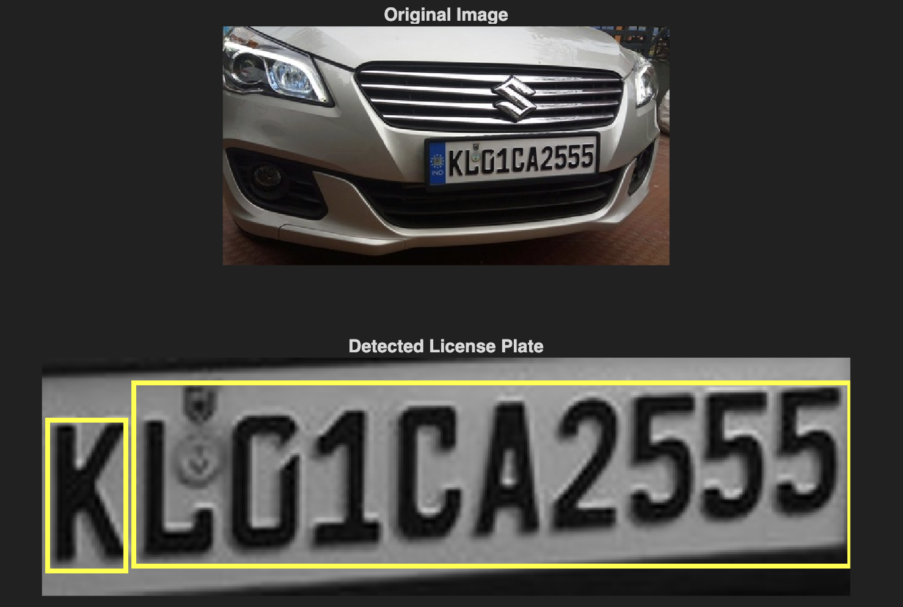
Recognize Detected Text Using OCR
After detecting the text regions, use the OCR function to recognize the text within each bounding box. Note that without first finding the text regions, the output of the OCR function would be considerably more noisy.

Slide 21
References
[1] Chen, Huizhong, et al. "Robust Text Detection in Natural Images with Edge-Enhanced Maximally Stable Extremal Regions." Image Processing (ICIP), 2011 18th IEEE International Conference on. IEEE, 2011.
[2] Gonzalez, Alvaro, et al. "Text location in complex images." Pattern Recognition (ICPR), 2012 21st International Conference on. IEEE, 2012.
[3] Li, Yao, and Huchuan Lu. "Scene text detection via stroke width." Pattern Recognition (ICPR), 2012 21st International Conference on. IEEE, 2012.
[4] Neumann, Lukas, and Jiri Matas. "Real-time scene text localization and recognition." Computer Vision and Pattern Recognition (CVPR), 2012 IEEE Conference on. IEEE, 2012.
[5] https://www.mathworks.com/help/images/detecting-a-cell-using-image-segmentation.html

